Slide 1
BIEN 401 Biomedical Mass Transport Class 12 Diffusion in Tissue Krogh’s Cylinder Model
notes prepared by
Dr. Louis Reis
Created on 4/2/2022

Slide 2
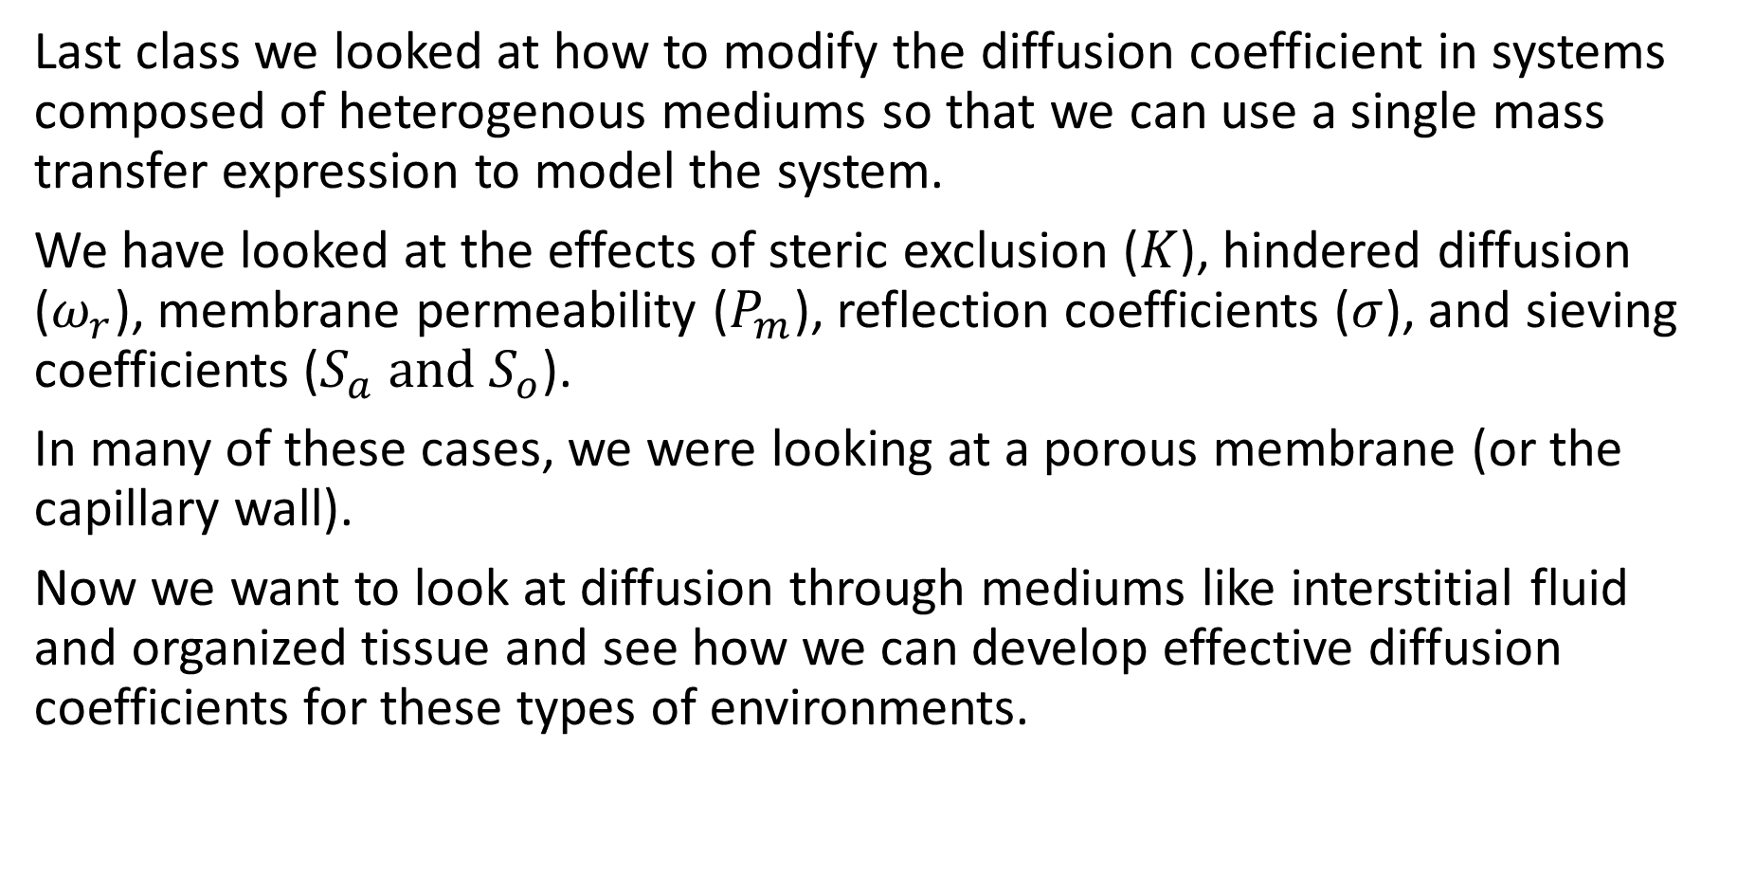
Effective Diffusivities
Last class we looked at how to modify the diffusion coefficient in systems composed of heterogenous mediums so that we can use a single mass transfer expression to model the system.
We have looked at the effects of steric exclusion ($K$), hindered diffusion ($ω_{r}$), membrane permeability ($P_{m}$), reflection coefficients ($σ$), and sieving coefficients ($S_{a} \text{and} S_{o}$).
In many of these cases, we were looking at a porous membrane (or the capillary wall).
Now we want to look at diffusion through mediums like interstitial fluid and organized tissue and see how we can develop effective diffusion coefficients for these types of environments.

Slide 3
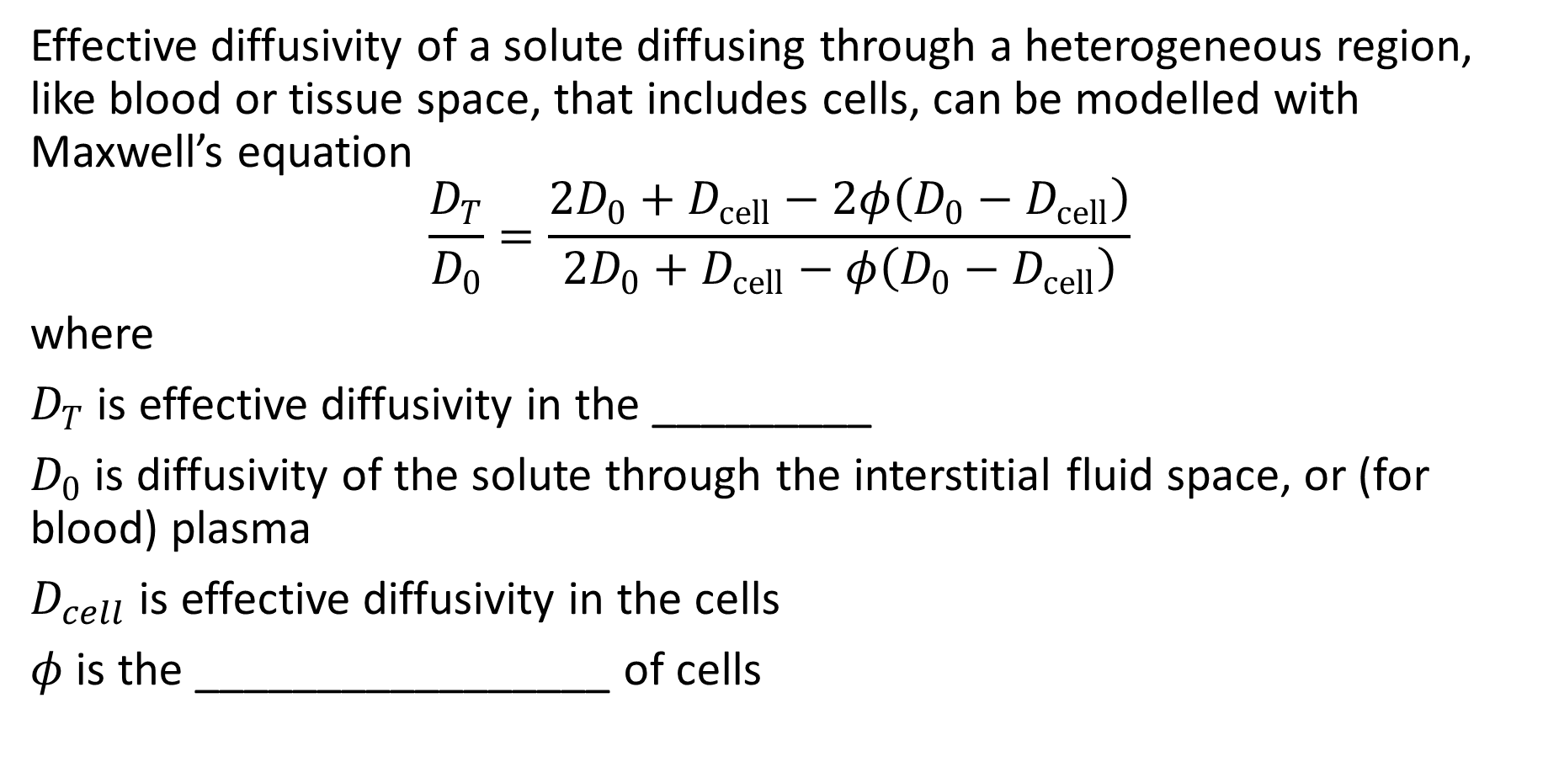
Effect of Cells on Diffusion
Effective diffusivity of a solute diffusing through a heterogeneous region, like blood or tissue space, that includes cells, can be modelled with Maxwell’s equation
$$\frac{D_{T}}{D_{0}}=\frac{2D_{0}+D_{cell}−2φ\left(D_{0}−D_{cell}\right)}{2D_{0}+D_{cell}−φ\left(D_{0}−D_{cell}\right)}$$
where
$D_{T}$ is effective diffusivity in the _________
$D_{0}$ is diffusivity of the solute through the interstitial fluid space, or (for blood) plasma
$D_{cell}$ is effective diffusivity in the cells
$φ$ is the _________________ of cells

Slide 4
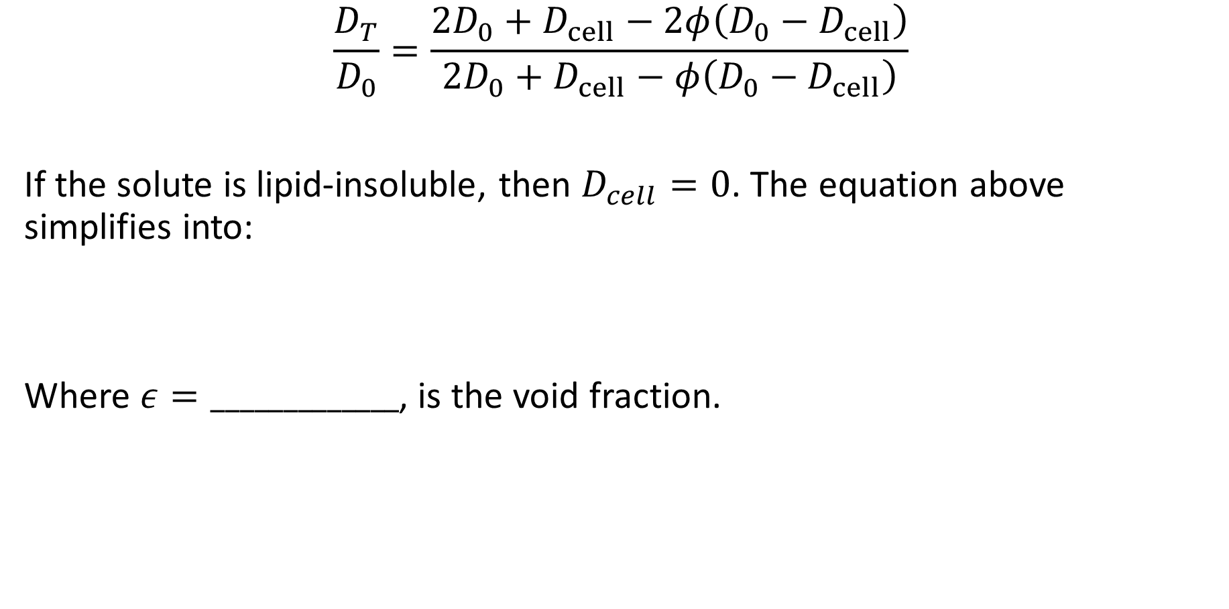
Effect of Cells on Diffusion
$$\frac{D_{T}}{D_{0}}=\frac{2D_{0}+D_{cell}−2φ\left(D_{0}−D_{cell}\right)}{2D_{0}+D_{cell}−φ\left(D_{0}−D_{cell}\right)}$$
If the solute is lipid-insoluble, then $D_{cell}=0$. The equation above simplifies into:
Where $ε=_____________$, is the void fraction.

Slide 5
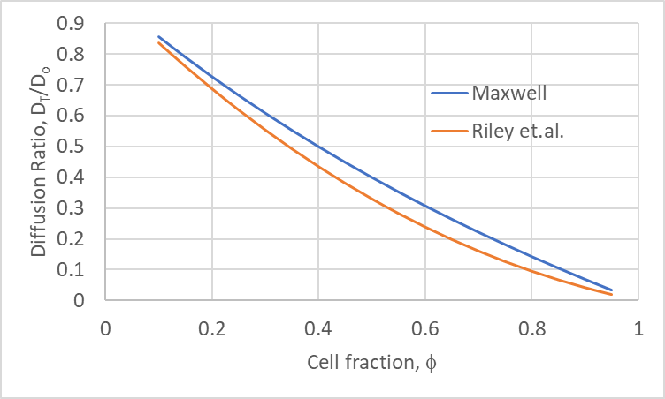

Effect of Cells on Diffusion
Alternatively, Riley et al. have developed a relationship based on Monte Carlo simulations.
$$\frac{D_{T}}{D_{0}}=1−\left(1−\frac{D_{cell}}{D_{0}}\right)\left(1.727φ−0.8177φ^{2}+0.09075φ^{3}\right)$$
Valid for
$$0.04<φ<0.95$$

Slide 6
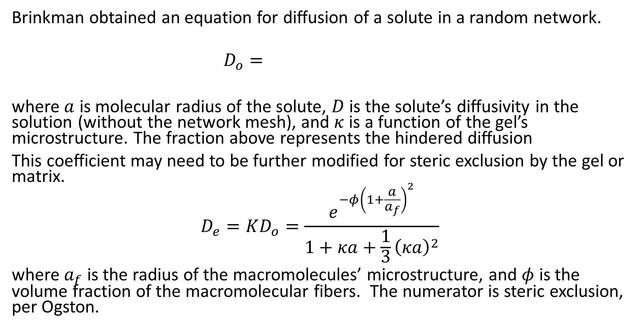
Diffusion in a Random Matrix
Brinkman obtained an equation for diffusion of a solute in a random network.
$$D_{o}=$$
where $a$ is molecular radius of the solute, $D$ is the solute’s diffusivity in the solution (without the network mesh), and $κ$ is a function of the gel’s microstructure. The fraction above represents the hindered diffusion
This coefficient may need to be further modified for steric exclusion by the gel or matrix.
$$D_{e}=KD_{o}=\frac{e^{−φ{\left(1+\frac{a}{a_{f}}\right)}^{2}}}{1+κa+\frac{1}{3}{\left(κa\right)}^{2}}$$
where $a_{f}$ is the radius of the macromolecules’ microstructure, and $φ$ is the volume fraction of the macromolecular fibers. The numerator is steric exclusion, per Ogston.

Slide 7
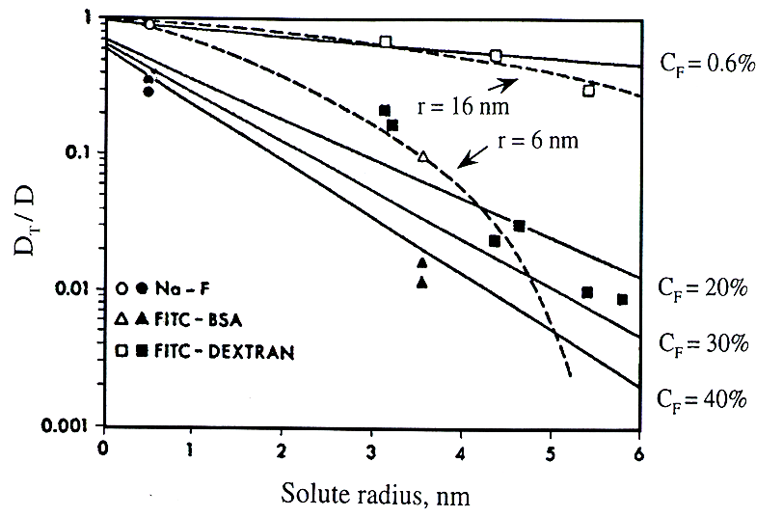
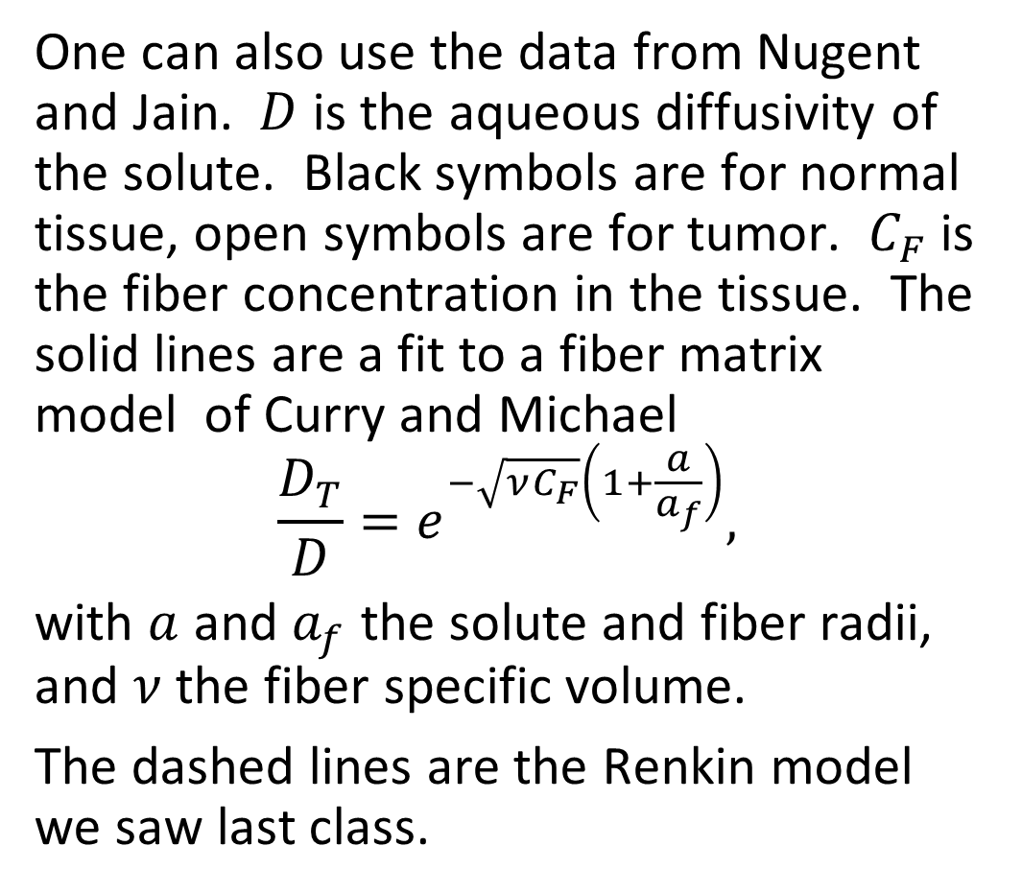
Diffusion in a Random Matrix
One can also use the data from Nugent and Jain. $D$ is the aqueous diffusivity of the solute. Black symbols are for normal tissue, open symbols are for tumor. $C_{F}$ is the fiber concentration in the tissue. The solid lines are a fit to a fiber matrix model of Curry and Michael
$$\frac{D_{T}}{D}=e^{−\sqrt{νC_{F}}\left(1+\frac{a}{a_{f}}\right)},$$
with $a$ and $a_{f}$ the solute and fiber radii, and $ν$ the fiber specific volume.
The dashed lines are the Renkin model we saw last class.

Slide 8
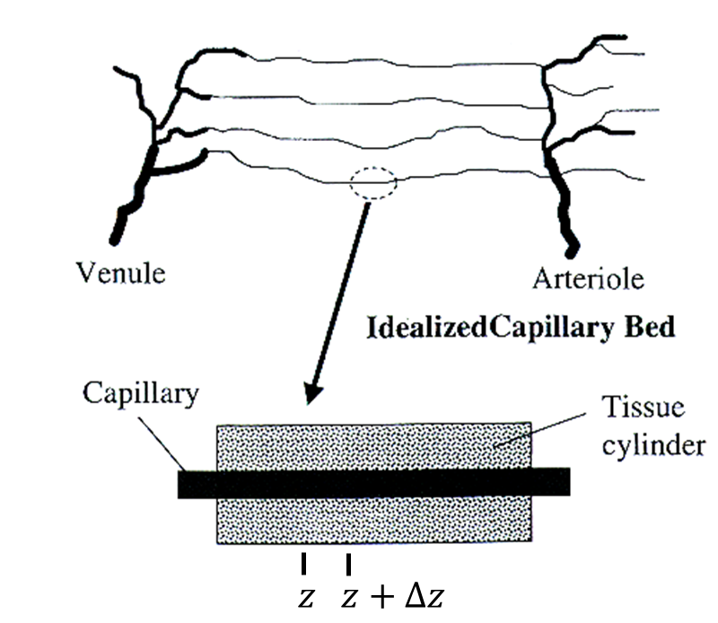
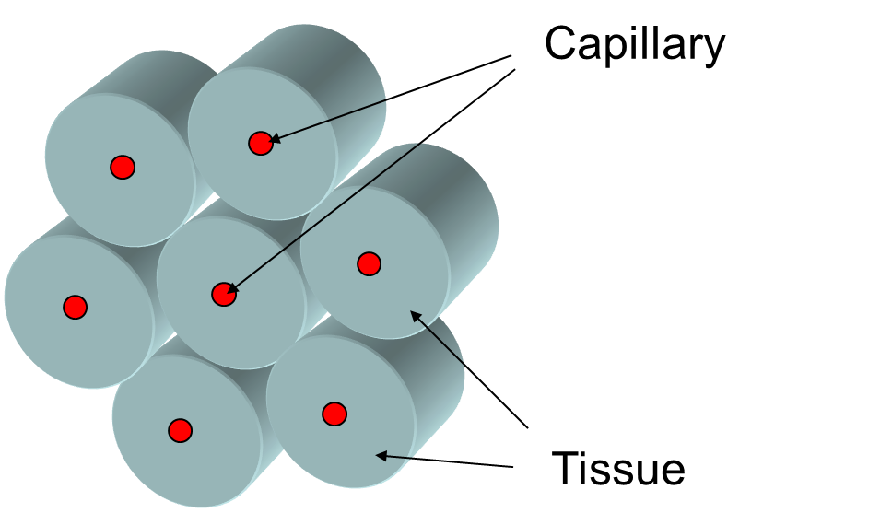
Krogh Tissue Cylinder
We can assume the capillaries to be arranged in parallel, and separated by an equal lateral distance. Each capillary is surrounded by a cylinder of tissue that oxygen and other solutes diffuse through. Krogh (1919) developed the cylinders to model the supply of oxygen to muscles.

Slide 9
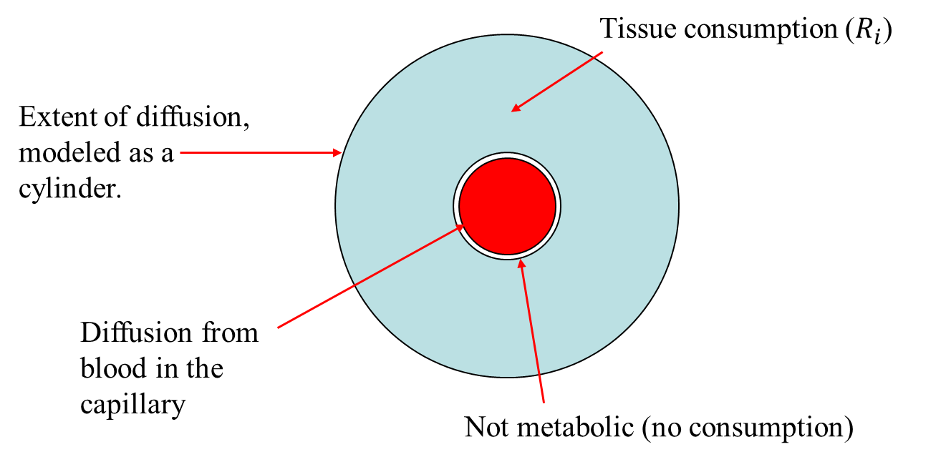
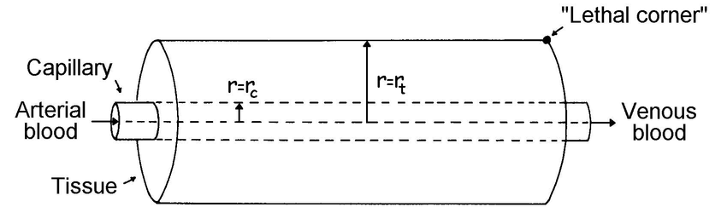
Krogh Tissue Cylinder
We assume that any solutes leaving the capillary and entering the tissue (e.g., oxygen) will be consumed from metabolic processes within the surrounding tissue. At some distance away from the capillary enough solute has been consumed or another capillary is closer, such that either the solute flux or solute concentration drops to zero.
In addition as solute leaves the capillary, the solute concentration in the blood and surrounding tissue will decrease. The lowest concentration of oxygen in the tissue will occur outside the venule side at the furthest edge of the cylinder (sometimes known as the lethal corner).

Slide 10
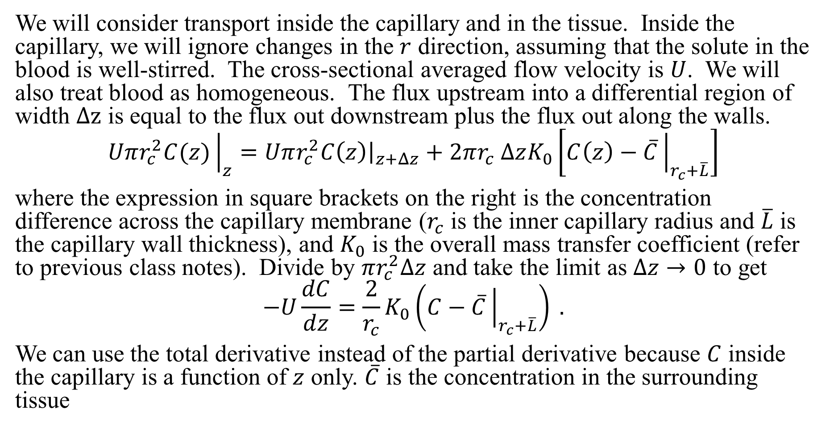
Mass Balance insider Capillary
We will consider transport inside the capillary and in the tissue. Inside the capillary, we will ignore changes in the $r$ direction, assuming that the solute in the blood is well-stirred. The cross-sectional averaged flow velocity is $U$. We will also treat blood as homogeneous. The flux upstream into a differential region of width $Δz$ is equal to the flux out downstream plus the flux out along the walls.
$$Uπr_{c}^{2}C(z){\left.​\right|}_{z}=Uπr_{c}^{2}{C\left(z\right)\left.​\right|}_{z+Δz}+2πr_{c} ΔzK_{0}\left[C\left(z\right)−\overline{C}{\left.​\right|}_{r_{c}+\overline{L}}\right]$$
where the expression in square brackets on the right is the concentration difference across the capillary membrane ($r_{c}$ is the inner capillary radius and $\overline{L}$ is the capillary wall thickness), and $K_{0}$ is the overall mass transfer coefficient (refer to previous class notes). Divide by $πr_{c}^{2}Δz$ and take the limit as $Δz→0$ to get
$$−U\frac{dC}{dz}=\frac{2}{r_{c}}K_{0}\left(C−\overline{C}{\left.​\right|}_{r_{c}+\overline{L}}\right) .$$
We can use the total derivative instead of the partial derivative because $C$ inside the capillary is a function of $z$ only. $\overline{C}$ is the concentration in the surrounding tissue

Slide 11
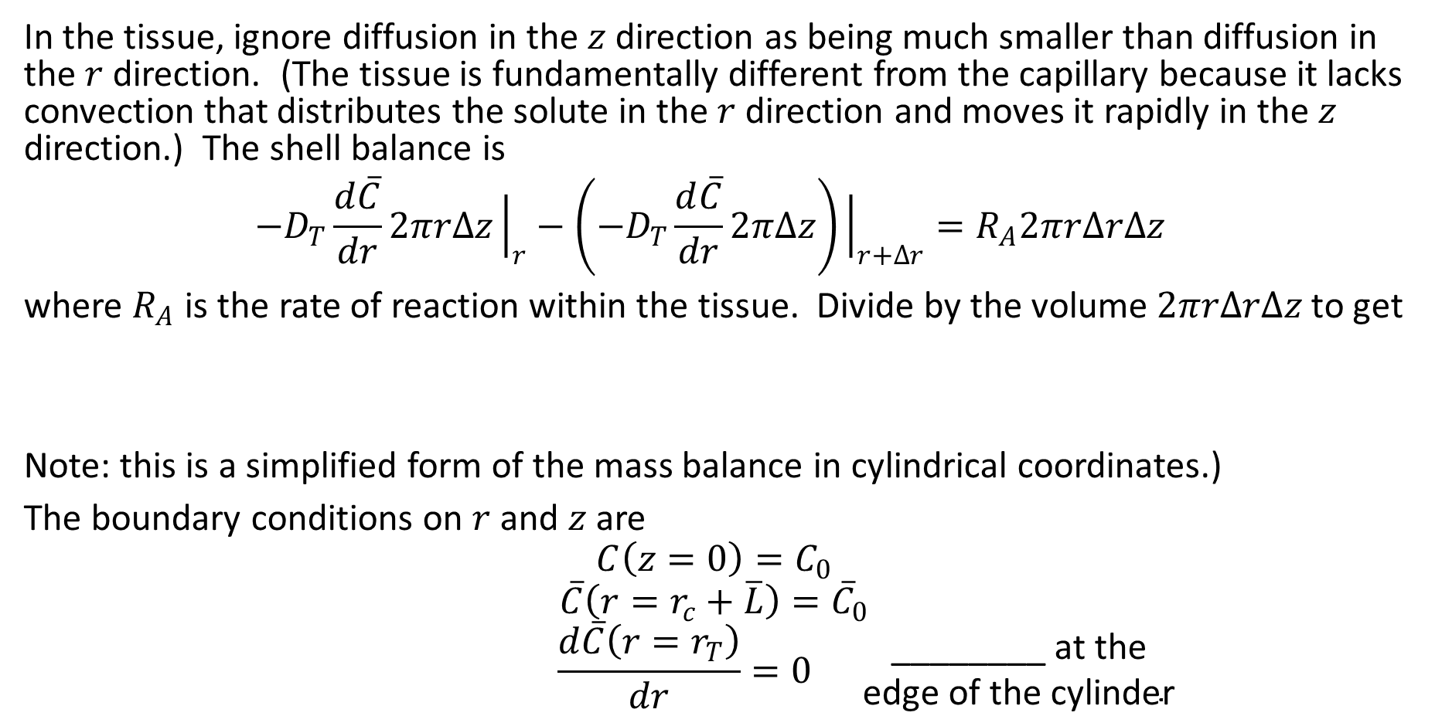
Mass Balance inside Tissue
In the tissue, ignore diffusion in the $z$ direction as being much smaller than diffusion in the $r$ direction. (The tissue is fundamentally different from the capillary because it lacks convection that distributes the solute in the $r$ direction and moves it rapidly in the $z$ direction.) The shell balance is
$${−D}_{T}\frac{d\overline{C}}{dr}2πrΔz{\left.​\right|}_{r}−\left(−D_{T}\frac{d\overline{C}}{dr}2πΔz\right){\left.​\right|}_{r+Δr}=R_{A}2πrΔrΔz$$
where $R_{A}$ is the rate of reaction within the tissue. Divide by the volume $2πrΔrΔz$ to get
Note: this is a simplified form of the mass balance in cylindrical coordinates.)
The boundary conditions on $r$ and $z$ are
$$C\left(z=0\right)=C_{0}$$
$$\overline{C}\left(r=r_{c}+\overline{L}\right)={\overline{C}}_{0}$$
$$\frac{d\overline{C}\left(r=r_{T}\right)}{dr}=0 \begin{matrix}\text{________} \text{at} \text{the} \\ \text{edge} \text{of} \text{the} \text{cylinder}\end{matrix}$$

Slide 12
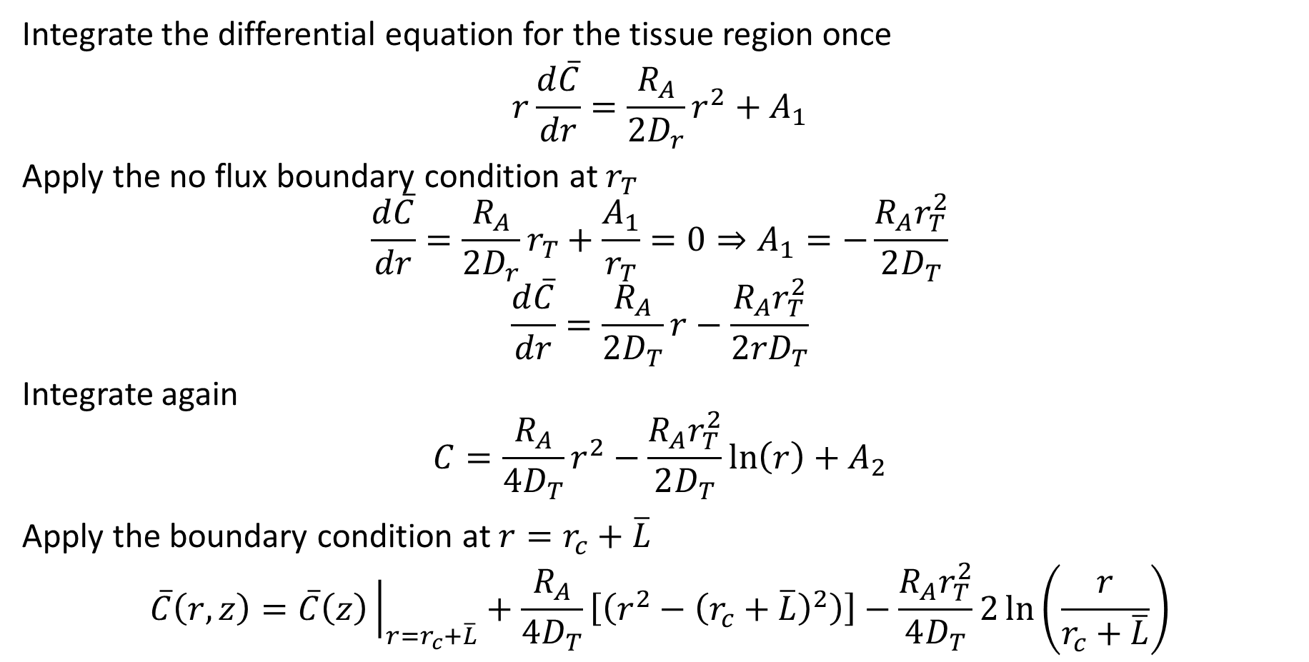
Mass Balance inside Tissue
Integrate the differential equation for the tissue region once
$$r\frac{d\overline{C}}{dr}=\frac{R_{A}}{2D_{r}}r^{2}+A_{1}$$
Apply the no flux boundary condition at $r_{T}$
$$\frac{d\overline{C}}{dr}=\frac{R_{A}}{2D_{r}}r_{T}+\frac{A_{1}}{r_{T}}=0⇒A_{1}=−\frac{R_{A}r_{T}^{2}}{2D_{T}}$$
$$\frac{d\overline{C}}{dr}=\frac{R_{A}}{2D_{T}}r−\frac{R_{A}r_{T}^{2}}{2{rD}_{T}}$$
Integrate again
$$C=\frac{R_{A}}{4D_{T}}r^{2}−\frac{R_{A}r_{T}^{2}}{2D_{T}}\ln\left(r\right)+A_{2}$$
Apply the boundary condition at $r=r_{c}+\overline{L}$
$$\overline{C}\left(r,z\right)=\overline{C}\left(z\right){\left.​\right|}_{r=r_{c}+\overline{L}}+\frac{R_{A}}{4D_{T}}\left[\left(r^{2}−{\left(r_{c}+\overline{L}\right)}^{2}\right)\right]−\frac{R_{A}r_{T}^{2}}{4D_{T}}2\ln\left(\frac{r}{r_{c}+\overline{L}}\right)$$

Slide 13
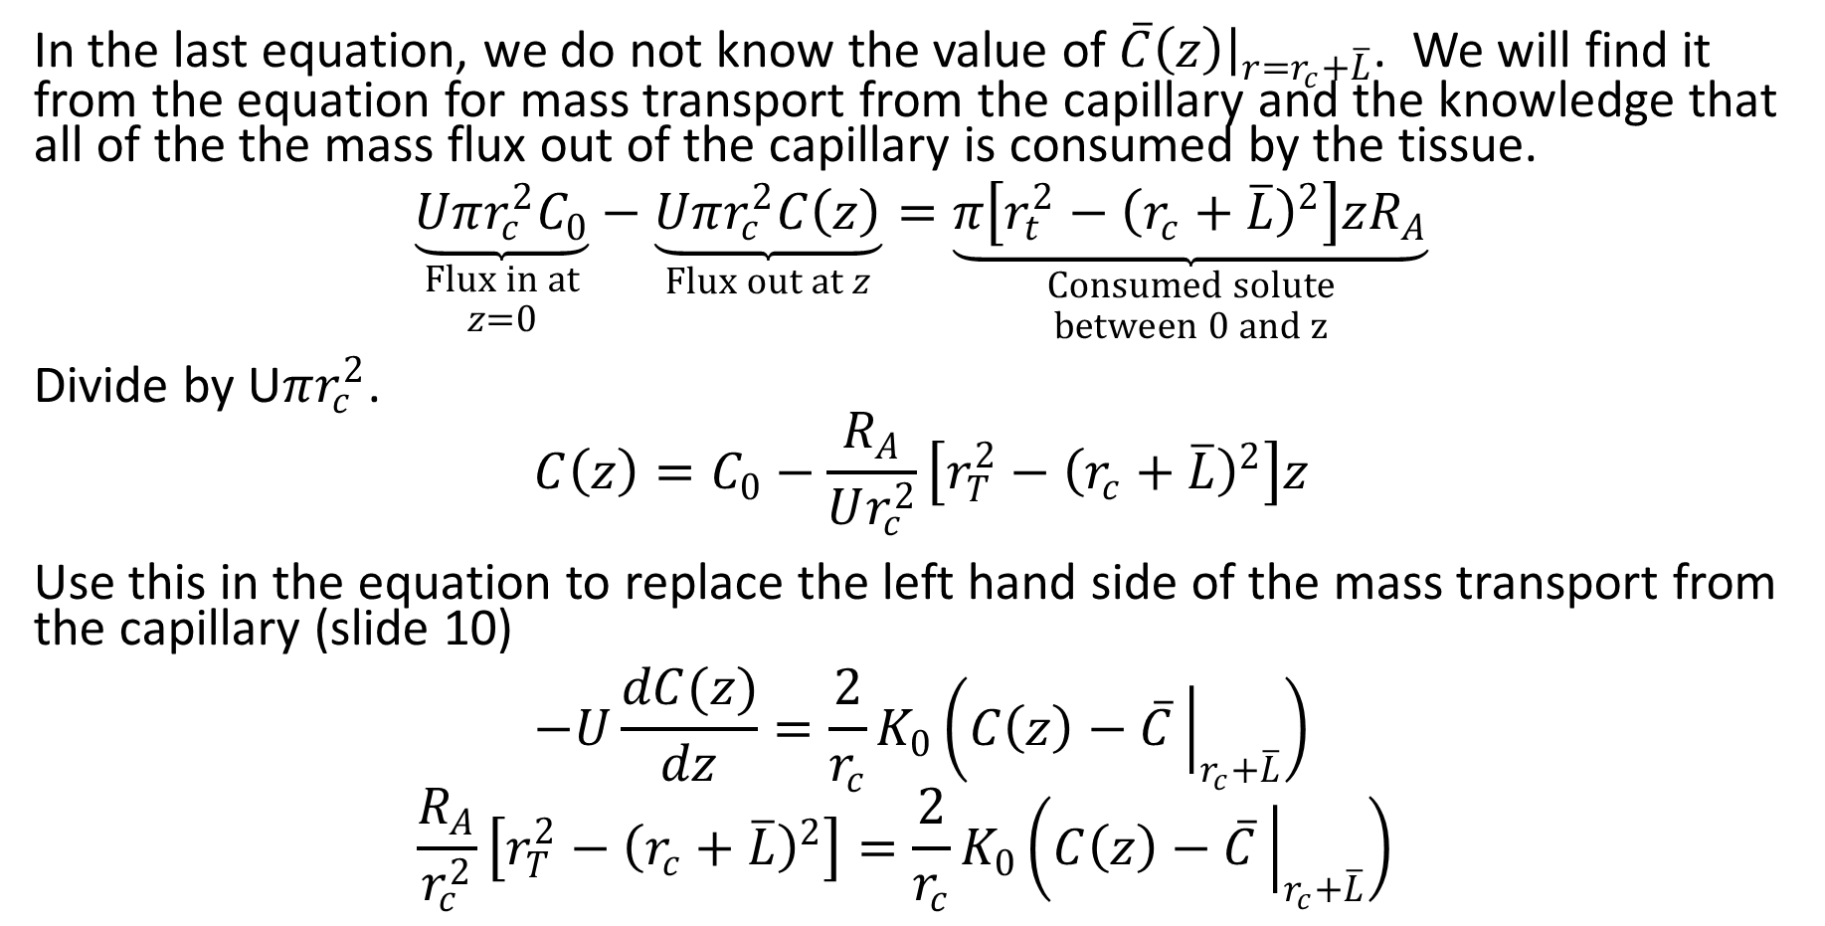
Overall Mass Balance
In the last equation, we do not know the value of $\overline{C}\left(z\right){\left.​\right|}_{r=r_{c}+\overline{L}}$. We will find it from the equation for mass transport from the capillary and the knowledge that all of the the mass flux out of the capillary is consumed by the tissue.
$$\underset{\begin{aligned}Flux in at \\ z=0\end{aligned}}{\underbrace{Uπr_{c}^{2}C_{0}}}−\underset{Flux out at z}{\underbrace{Uπr_{c}^{2}C\left(z\right)}}=\underset{\begin{aligned}Consumed solute \\ between 0 and z\end{aligned}}{\underbrace{π\left[r_{t}^{2}−{\left(r_{c}+\overline{L}\right)}^{2}\right]zR_{A}}}$$
Divide by U$πr_{c}^{2}$.
$$C\left(z\right)=C_{0}−\frac{R_{A}}{Ur_{c}^{2}}\left[r_{T}^{2}−{\left(r_{c}+\overline{L}\right)}^{2}\right]z$$
Use this in the equation to replace the left hand side of the mass transport from the capillary (slide 10)
$$−U\frac{dC(z)}{dz}=\frac{2}{r_{c}}K_{0}\left(C\left(z\right)−\overline{C}{\left.​\right|}_{r_{c}+\overline{L}}\right)$$
$$\frac{R_{A}}{r_{c}^{2}}\left[r_{T}^{2}−{\left(r_{c}+\overline{L}\right)}^{2}\right]=\frac{2}{r_{c}}K_{0}\left(C\left(z\right)−\overline{C}{\left.​\right|}_{r_{c}+\overline{L}}\right)$$

Slide 14
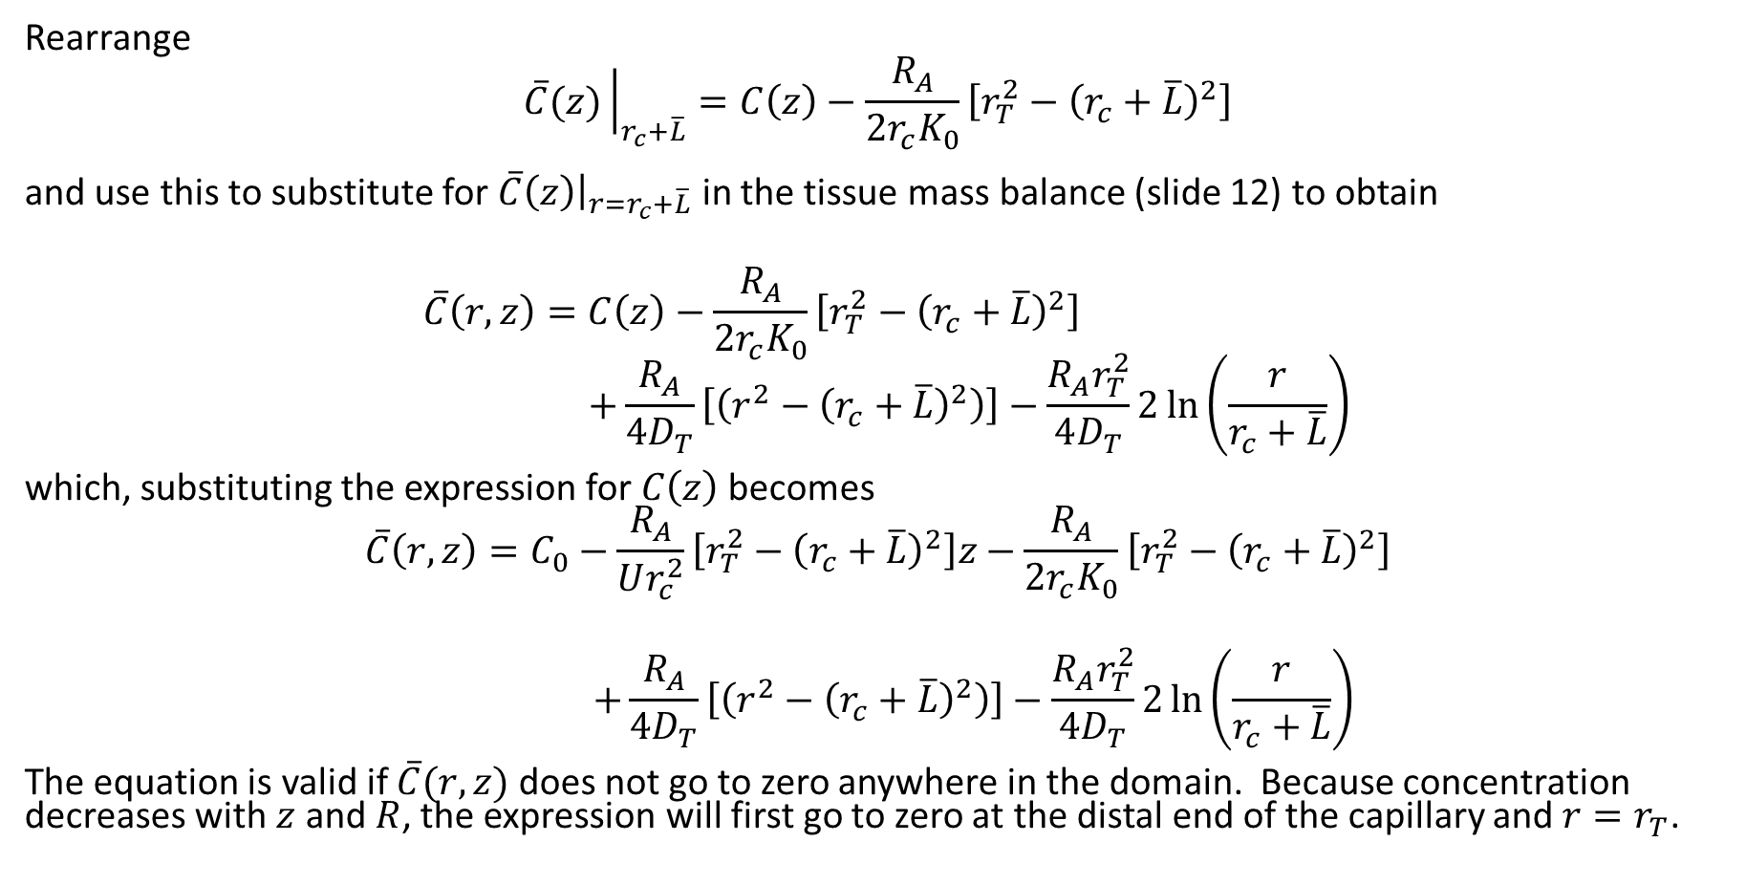
Concentration Profile in the Cylinder
Rearrange
$$\overline{C}(z){\left.​\right|}_{r_{c}+\overline{L}}=C\left(z\right)−\frac{R_{A}}{{2r}_{c}K_{0}}\left[r_{T}^{2}−{\left(r_{c}+\overline{L}\right)}^{2}\right]$$
and use this to substitute for $\overline{C}\left(z\right){\left.​\right|}_{r=r_{c}+\overline{L}}$ in the tissue mass balance (slide 12) to obtain
$$\overline{C}\left(r,z\right)=C\left(z\right)−\frac{R_{A}}{{2r}_{c}K_{0}}\left[r_{T}^{2}−{\left(r_{c}+\overline{L}\right)}^{2}\right]$$
$$+\frac{R_{A}}{4D_{T}}\left[\left(r^{2}−{\left(r_{c}+\overline{L}\right)}^{2}\right)\right]−\frac{R_{A}r_{T}^{2}}{4D_{T}}2\ln\left(\frac{r}{r_{c}+\overline{L}}\right)$$
which, substituting the expression for $C\left(z\right)$becomes
$$\overline{C}\left(r,z\right)=C_{0}−\frac{R_{A}}{Ur_{c}^{2}}\left[r_{T}^{2}−{\left(r_{c}+\overline{L}\right)}^{2}\right]z−\frac{R_{A}}{{2r}_{c}K_{0}}\left[r_{T}^{2}−{\left(r_{c}+\overline{L}\right)}^{2}\right]$$
$$+\frac{R_{A}}{4D_{T}}\left[\left(r^{2}−{\left(r_{c}+\overline{L}\right)}^{2}\right)\right]−\frac{R_{A}r_{T}^{2}}{4D_{T}}2\ln\left(\frac{r}{r_{c}+\overline{L}}\right)$$
The equation is valid if $\overline{C}(r,z)$ does not go to zero anywhere in the domain. Because concentration decreases with $z$ and $R$, the expression will first go to zero at the distal end of the capillary and $r=r_{T}$.

Slide 15
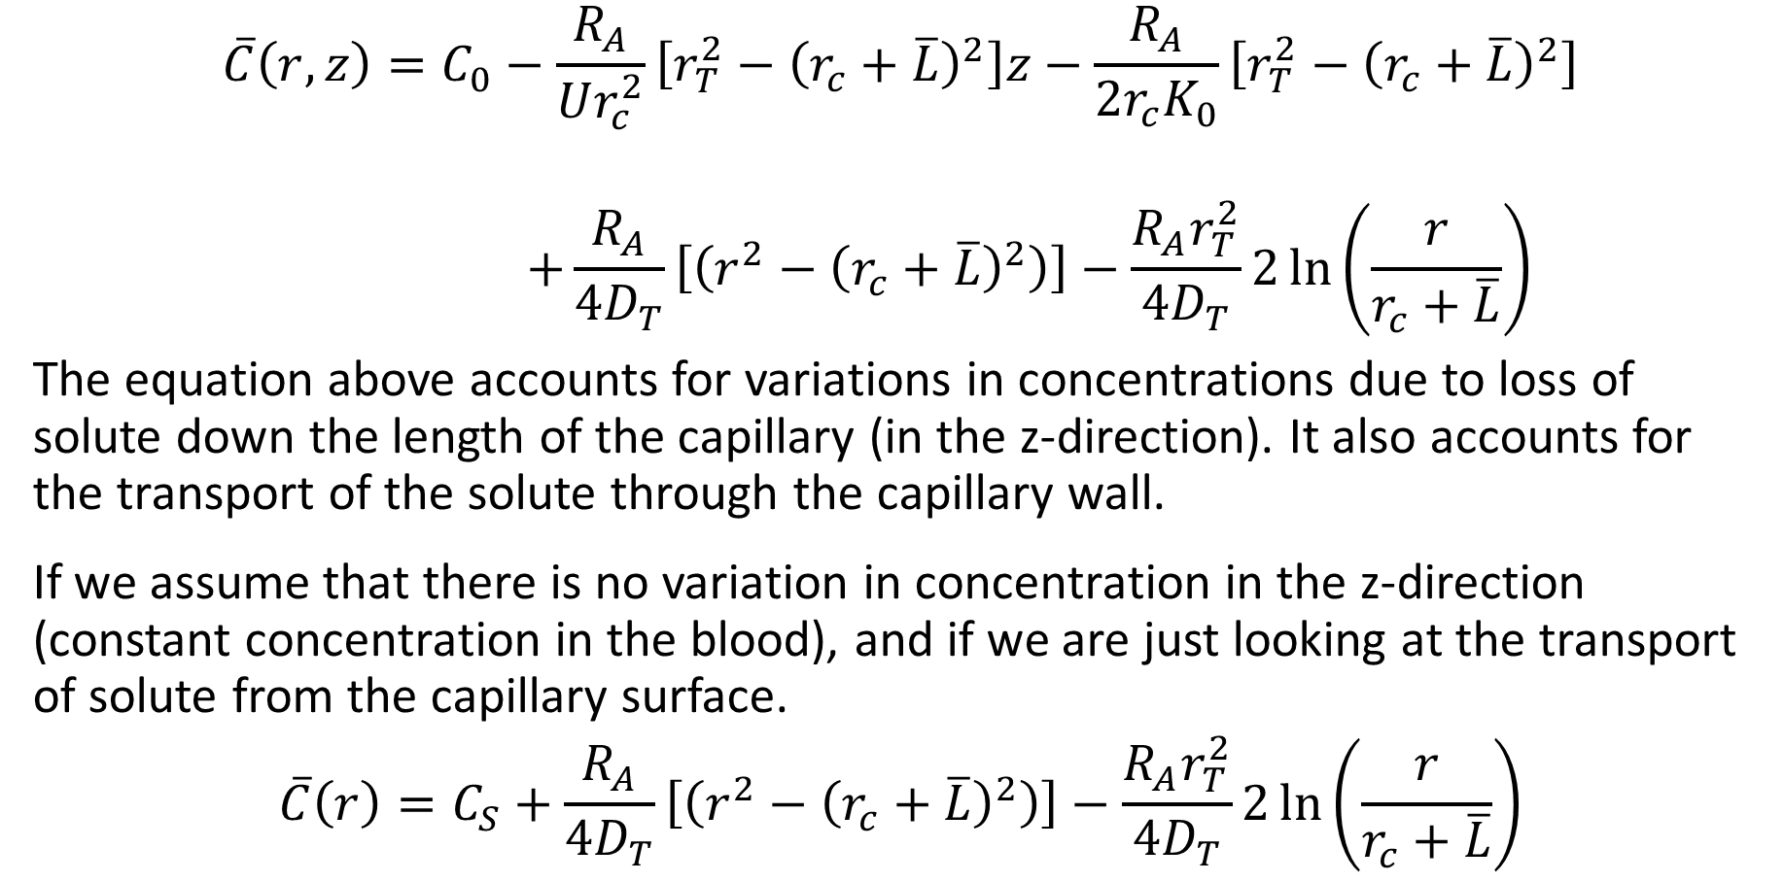
Krogh Cylinder Summary
$$\overline{C}\left(r,z\right)=C_{0}−\frac{R_{A}}{Ur_{c}^{2}}\left[r_{T}^{2}−{\left(r_{c}+\overline{L}\right)}^{2}\right]z−\frac{R_{A}}{{2r}_{c}K_{0}}\left[r_{T}^{2}−{\left(r_{c}+\overline{L}\right)}^{2}\right]$$
$$+\frac{R_{A}}{4D_{T}}\left[\left(r^{2}−{\left(r_{c}+\overline{L}\right)}^{2}\right)\right]−\frac{R_{A}r_{T}^{2}}{4D_{T}}2\ln\left(\frac{r}{r_{c}+\overline{L}}\right)$$
The equation above accounts for variations in concentrations due to loss of solute down the length of the capillary (in the z-direction). It also accounts for the transport of the solute through the capillary wall.
If we assume that there is no variation in concentration in the z-direction (constant concentration in the blood), and if we are just looking at the transport of solute from the capillary surface.
$$\overline{C}\left(r\right)=C_{S}+\frac{R_{A}}{4D_{T}}\left[\left(r^{2}−{\left(r_{c}+\overline{L}\right)}^{2}\right)\right]−\frac{R_{A}r_{T}^{2}}{4D_{T}}2\ln\left(\frac{r}{r_{c}+\overline{L}}\right)$$

Slide 16

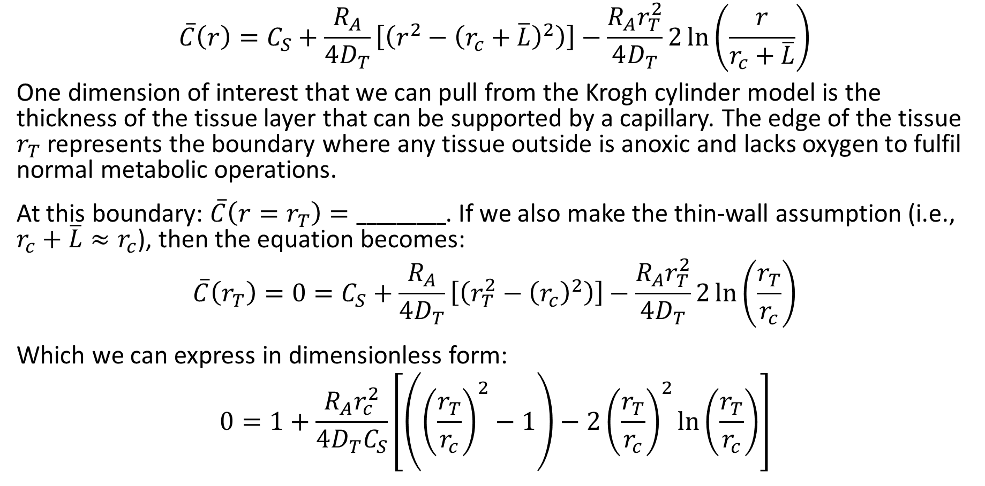
Critical Radius
$$\overline{C}\left(r\right)=C_{S}+\frac{R_{A}}{4D_{T}}\left[\left(r^{2}−{\left(r_{c}+\overline{L}\right)}^{2}\right)\right]−\frac{R_{A}r_{T}^{2}}{4D_{T}}2\ln\left(\frac{r}{r_{c}+\overline{L}}\right)$$
One dimension of interest that we can pull from the Krogh cylinder model is the thickness of the tissue layer that can be supported by a capillary. The edge of the tissue $r_{T}$ represents the boundary where any tissue outside is anoxic and lacks oxygen to fulfil normal metabolic operations.
At this boundary: $\overline{C}\left(r=r_{T}\right)=_________$. If we also make the thin-wall assumption (i.e., $r_{c}+\overline{L}≈r_{c}$), then the equation becomes:
$$\overline{C}\left(r_{T}\right)=0=C_{S}+\frac{R_{A}}{4D_{T}}\left[\left(r_{T}^{2}−{\left(r_{c}\right)}^{2}\right)\right]−\frac{R_{A}r_{T}^{2}}{4D_{T}}2\ln\left(\frac{r_{T}}{r_{c}}\right)$$
Which we can express in dimensionless form:
$$0=1+\frac{R_{A}r_{c}^{2}}{4D_{T}C_{S}}\left[\left({\left(\frac{r_{T}}{r_{c}}\right)}^{2}−1\right)−2{\left(\frac{r_{T}}{r_{c}}\right)}^{2}\ln\left(\frac{r_{T}}{r_{c}}\right)\right]$$
Note the units of:
$$\frac{R_{A}r_{c}^{2}}{4D_{T}C_{S}}=$$

Slide 17
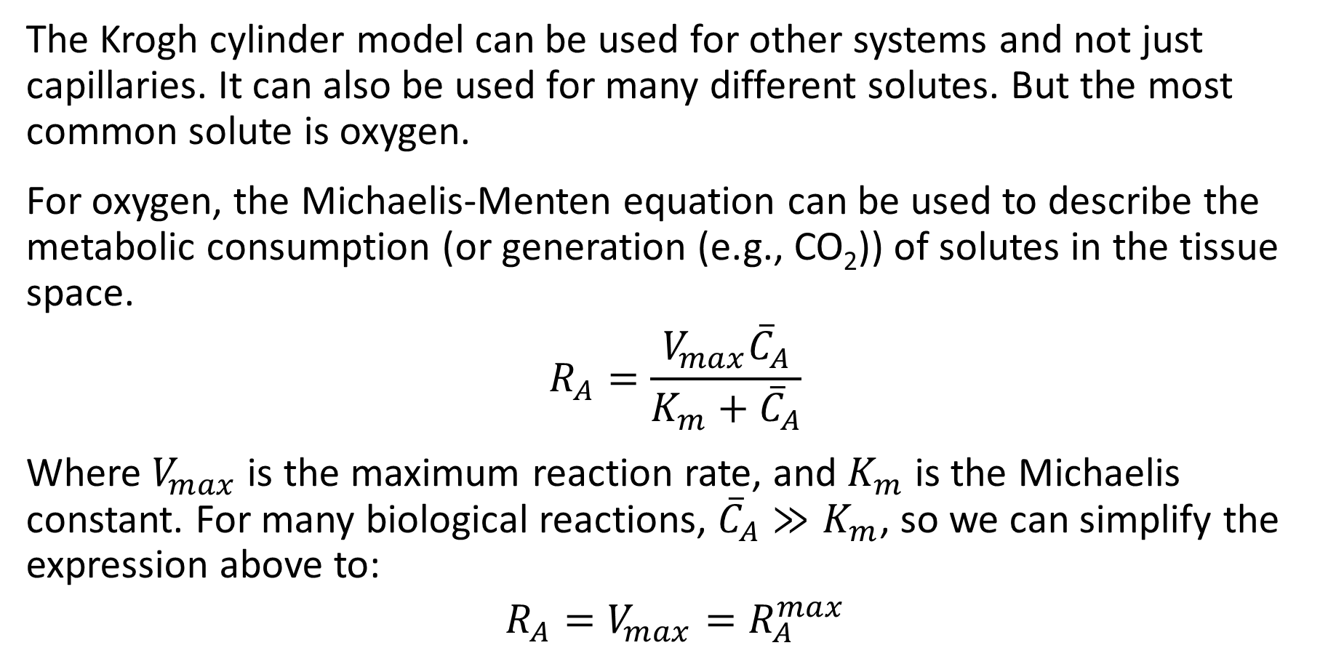
Reaction Rate of Oxygen
The Krogh cylinder model can be used for other systems and not just capillaries. It can also be used for many different solutes. But the most common solute is oxygen.
For oxygen, the Michaelis-Menten equation can be used to describe the metabolic consumption (or generation (e.g., CO₂)) of solutes in the tissue space.
$$R_{A}=\frac{V_{max}{\overline{C}}_{A}}{K_{m}+{\overline{C}}_{A}}$$
Where $V_{max}$ is the maximum reaction rate, and $K_{m}$ is the Michaelis constant. For many biological reactions, ${\overline{C}}_{A}≫K_{m}$, so we can simplify the expression above to:
$$R_{A}=V_{max}=R_{A}^{max}$$

Slide 18
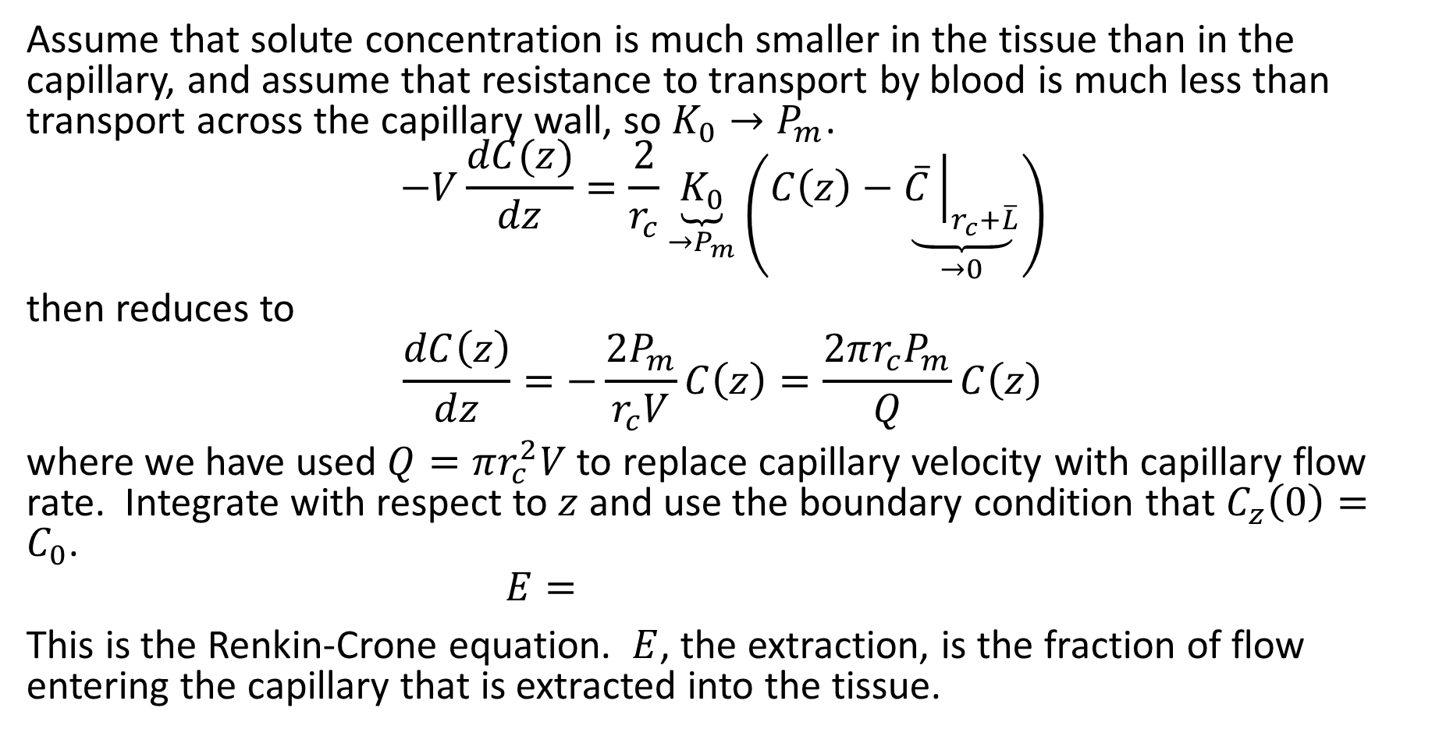
Renkin-Crone Equation
Assume that solute concentration is much smaller in the tissue than in the capillary, and assume that resistance to transport by blood is much less than transport across the capillary wall, so $K_{0}→P_{m}$.
$$−V\frac{dC(z)}{dz}=\frac{2}{r_{c}}\underset{→P_{m}}{\underbrace{K_{0}}}\left(C\left(z\right)−\underset{→0}{\underbrace{\overline{C}{\left.​\right|}_{r_{c}+\overline{L}}}}\right)$$
then reduces to
$$\frac{dC\left(z\right)}{dz}=−\frac{2P_{m}}{r_{c}V}C\left(z\right)=\frac{2πr_{c}P_{m}}{Q}C\left(z\right)$$
where we have used $Q=πr_{c}^{2}V$ to replace capillary velocity with capillary flow rate. Integrate with respect to $z$ and use the boundary condition that $C_{z}\left(0\right)=C_{0}$.
$$E=$$
This is the Renkin-Crone equation. $E$, the extraction, is the fraction of flow entering the capillary that is extracted into the tissue.

Slide 19
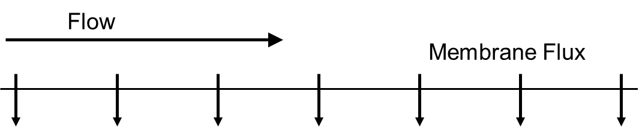
Flow-limited vs. Diffusion-limited
If transport is _____ limited, it means that a large change in the diffusive flux has only a small effect on the total flux. I.e., it does not matter much how fast the diffusion is if the flow cannot carry away (or bring in) mass fast enough. This situation occurs when flow rate is small.
If the transport is _______ limited, it means that a large change in flow rate has only a small effect on the total flux. I.e., it does not matter how large the flow is if the mass cannot diffuse through the capillary wall fast enough. This situation occurs when permeability is small.

Slide 20
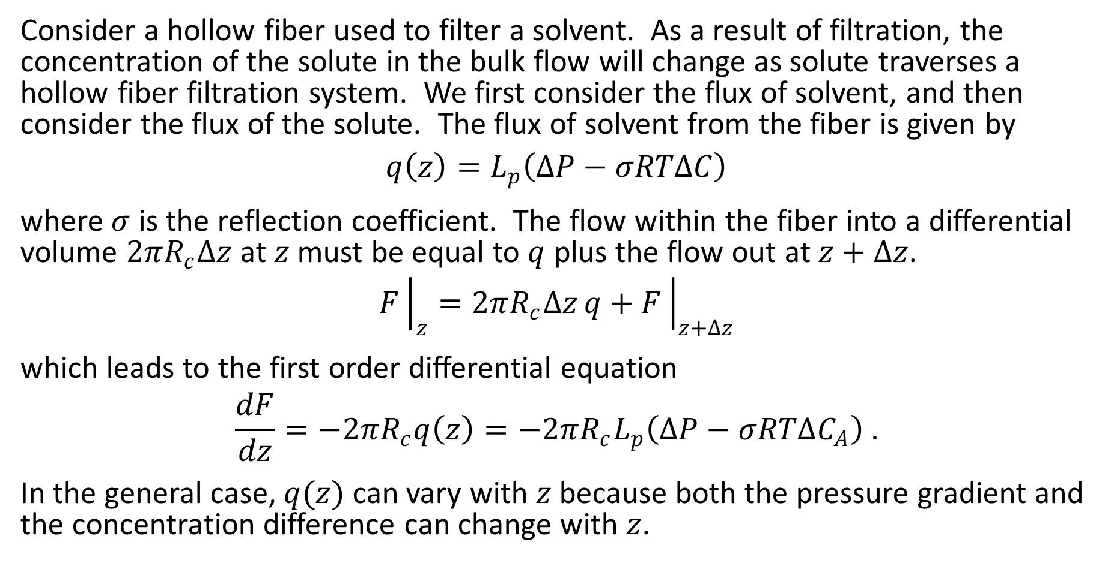
Filtration from a Hollow Fiber
Consider a hollow fiber used to filter a solvent. As a result of filtration, the concentration of the solute in the bulk flow will change as solute traverses a hollow fiber filtration system. We first consider the flux of solvent, and then consider the flux of the solute. The flux of solvent from the fiber is given by
$$q\left(z\right)=L_{p}\left(ΔP−σRTΔC\right)$$
where $σ$ is the reflection coefficient. The flow within the fiber into a differential volume $2πR_{c}Δz$ at $z$ must be equal to $q$ plus the flow out at $z+Δz$.
$$F{\left.​\right|}_{z}=2πR_{c}Δz q+F{\left.​\right|}_{z+Δz}$$
which leads to the first order differential equation
$$\frac{dF}{dz}=−2πR_{c}q\left(z\right)=−2πR_{c}L_{p}\left(ΔP−σRTΔC_{A}\right) .$$
In the general case, $q(z)$ can vary with $z$ because both the pressure gradient and the concentration difference can change with $z$.

Slide 21

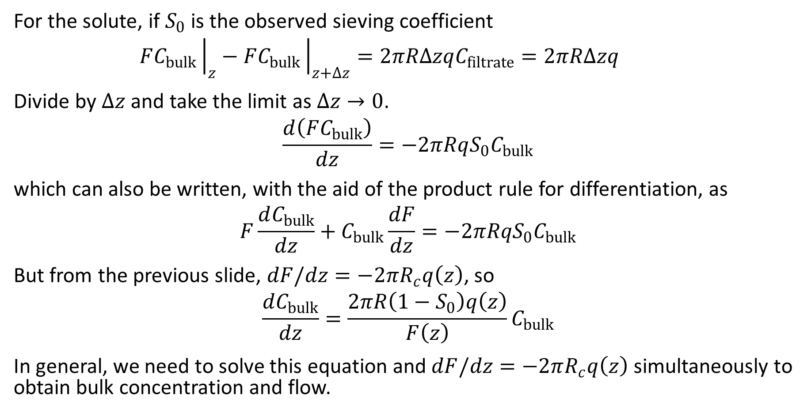
Filtration from a Hollow Fiber
Recall:
$$S_{O}=\frac{C_{filtrate}}{C_{bulk}}$$
For the solute, if $S_{0}$ is the observed sieving coefficient
$$FC_{bulk}{\left.​\right|}_{z}−FC_{bulk}{\left.​\right|}_{z+Δz}=2πRΔzqC_{filtrate}=2πRΔzq$$
Divide by $Δz$ and take the limit as $Δz→0$.
$$\frac{d\left(FC_{bulk}\right)}{dz}=−2πRqS_{0}C_{bulk}$$
which can also be written, with the aid of the product rule for differentiation, as
$$F\frac{dC_{bulk}}{dz}+C_{bulk}\frac{dF}{dz}=−2πRqS_{0}C_{bulk}$$
But from the previous slide, $dF/dz=−2πR_{c}q\left(z\right)$, so
$$\frac{dC_{bulk}}{dz}=\frac{2πR\left(1−S_{0}\right)q\left(z\right)}{F\left(z\right)}C_{bulk}$$
In general, we need to solve this equation and $dF/dz=−2πR_{c}q\left(z\right)$ simultaneously to obtain bulk concentration and flow.

Slide 22
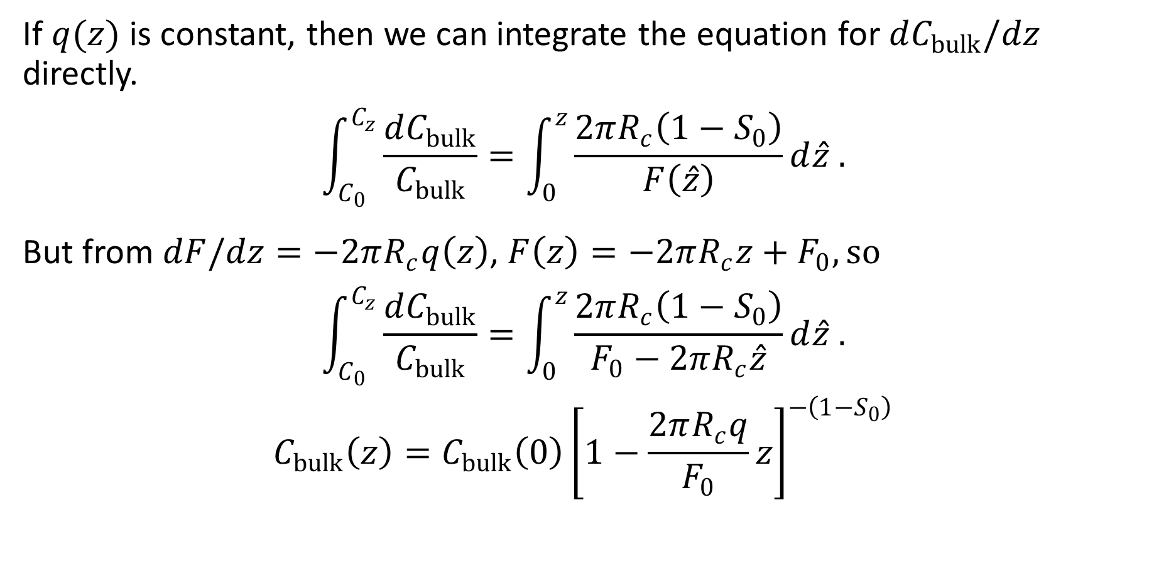
Filtration from a Hollow Fiber
Recall:
$$S_{O}=\frac{C_{filtrate}}{C_{bulk}}$$
If $q(z)$ is constant, then we can integrate the equation for $dC_{bulk}/dz$ directly.
$$\int_{C_{0}}^{C_{z}}{\frac{dC_{bulk}}{C_{bulk}}}=\int_{0}^{z}{\frac{2πR_{c}\left(1−S_{0}\right)}{F\left(\hat{z}\right)}}d\hat{z} .$$
But from $dF/dz=−2πR_{c}q\left(z\right)$, $F\left(z\right)=−2πR_{c}z+F_{0}, so$
$$\int_{C_{0}}^{C_{z}}{\frac{dC_{bulk}}{C_{bulk}}}=\int_{0}^{z}{\frac{2πR_{c}\left(1−S_{0}\right)}{F_{0}−2πR_{c}\hat{z}}}d\hat{z} .$$
$$C_{bulk}\left(z\right)=C_{bulk}\left(0\right){\left[1−\frac{2πR_{c}q}{F_{0}}z\right]}^{−\left(1−S_{0}\right)}$$

